Slide 1

Chapter 5.5
Model with Batch Service and Threshold Control
Performance Evaluation of the Internet of Things (IoT)
Module Course: Performance Evaluation of Distributed Systems
Prof. Tobias Hoßfeld, Summer Semester 2022

Slide 2

Disclaimer and Copyright Notice
Lecture slides, figures, and scripts are based on the open access text book “Performance Modeling and Analysis of Communication Networks”. The book and scripts are licensed under the Creative Commons License Attribution-ShareAlike 4.0 International (CC BY-SA 4.0). If you remix, transform, or build upon the material, you must distribute your contributions under the same license as the original.
The book must be cited and the disclaimer attached when using lectures slides or scripts.
Tran-Gia, P. & Hossfeld, T. (2021). Performance Modeling and Analysis of Communication Networks - A Lecture Note. Würzburg University Press. https://doi.org/10.25972/WUP-978-3-95826-153-2
Website to download book, exercises, slides and scripts: https://modeling.systems/

Slide 3
Chapter 5
5 Analysis of Non-Markovian Systems
5.1 Discrete-Time Markov Chain
5.2 Method of Embedded Markov Chain
5.2.1 Power Method for Numerical Derivation
5.2.2 Notion of Embedding Times
5.2.3 Kleinrock’s Result
5.3 Delay System M/GI/1
5.3.1 Model Structure and Parameters
5.3.2 Markov Chain and State Transition
5.3.3 State Equation
5.3.4 State Probabilities
5.3.5 Delay Distribution
5.3.6 Other System Characteristics
5.3.7 State Probabilities at Arbitrary Time
5.4 Delay System GI/M/1
5.4.1 Model Structure and Parameters
5.4.2 Markov Chain and State Transition
5.4.3 State Probabilities
5.4.4 State Analysis with Geometric Approach
5.4.5 Waiting Time Distribution
5.5 Model with Batch Service and Threshold Control
5.5.1 Model Structure and Parameters
5.5.2 Markov Chain and State Transition
5.5.3 State Probabilities and System Characteristics
5.6 Results for Continuous-Time GI/GI/1 Delay Systems
5.6.1 Characteristics of GI/GI/1 Delay Systems
5.6.2 Lindley Integral Eq. GI/GI/1 Systems
5.6.3 Kingman’s Approximation of Mean Waiting Times

Slide 4
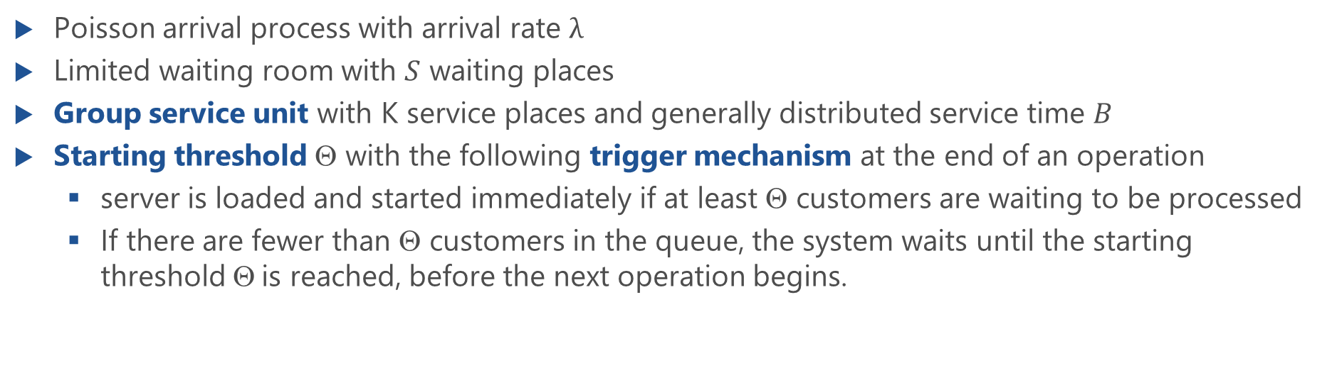
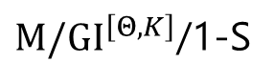
Model with Batch Service and Threshold Control
${M/GI}^{\left[Θ,K\right]}$/1-S
Poisson arrival process with arrival rate $λ$
Limited waiting room with $S$ waiting places
Group service unit with K service places and generally distributed service time $B$
Starting threshold $$ with the following trigger mechanism at the end of an operation
server is loaded and started immediately if at least $$ customers are waiting to be processed
If there are fewer than $$ customers in the queue, the system waits until the starting threshold $$is reached, before the next operation begins.

Slide 5
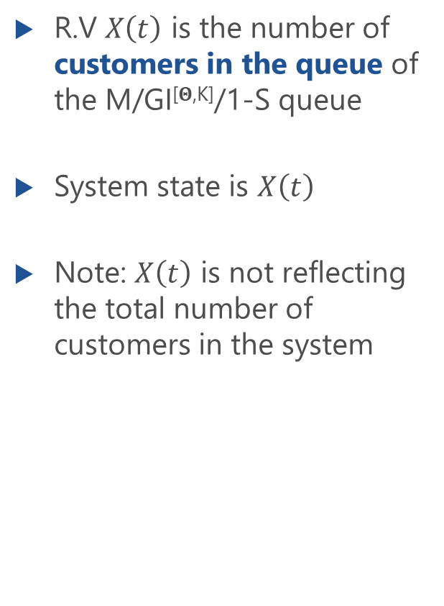
State Process
R.V $X\left(t\right)$ is the number of customers in the queue of the M/GI[$Θ$^{,K]}/1-S queue
System state is $X\left(t\right)$
Note: $X\left(t\right)$ is not reflecting the total number of customers in the system

Slide 6
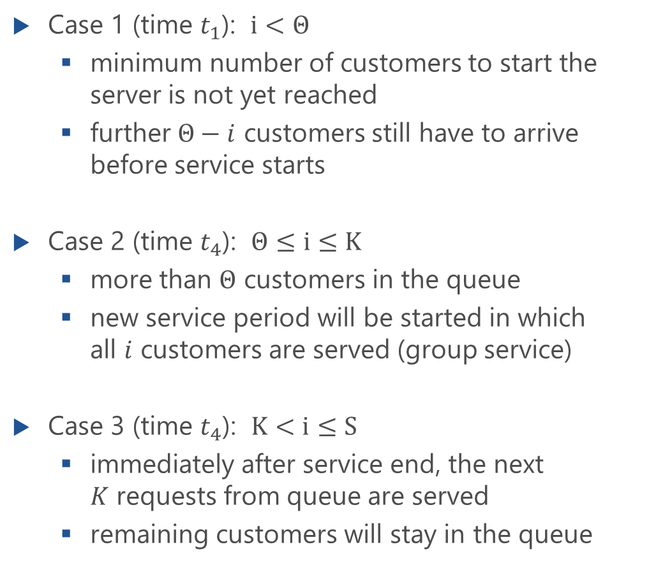
Different Cases in the State Process
Case 1 (time $t_{1}$): $i<Θ$
minimum number of customers to start the server is not yet reached
further $Θ−i$ customers still have to arrive before service starts
Case 2 (time $t_{4}$): $Θ≤i≤K$
more than $Θ$ customers in the queue
new service period will be started in which all $i$ customers are served (group service)
Case 3 (time $t_{4}$): $K<i≤S$
immediately after service end, the next $K$ requests from queue are served
remaining customers will stay in the queue

Slide 7
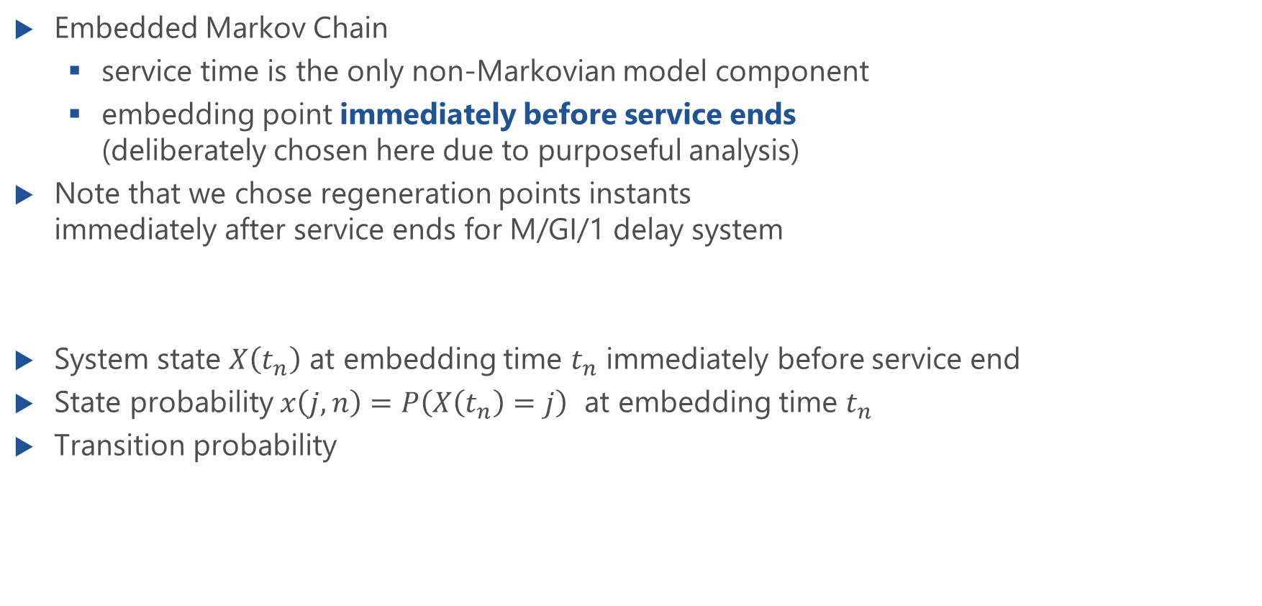
Markov Chain and State Transition
Embedded Markov Chain
service time is the only non-Markovian model component
embedding point immediately before service ends (deliberately chosen here due to purposeful analysis)
Note that we chose regeneration points instants immediately after service ends for M/GI/1 delay system
System state $X\left(t_{n}\right)$ at embedding time $t_{n}$ immediately before service end
State probability $x\left(j,n\right)=P\left(X\left(t_{n}\right)=j\right)$ at embedding time $t_{n}$
Transition probability
p
ij
j
i
2
2
1
1
0
0
t
n
t
n+1

Slide 8
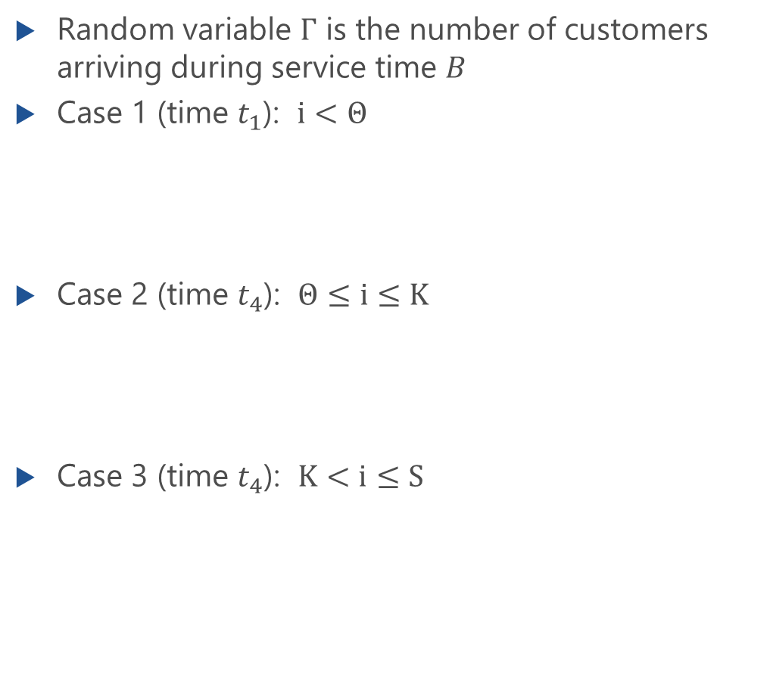
State Transition Probabilities
Random variable $Γ$ is the number of customers arriving during service time $B$
Case 1 (time $t_{1}$): $i<Θ$
Case 2 (time $t_{4}$): $Θ≤i≤K$
Case 3 (time $t_{4}$): $K<i≤S$

Slide 9
State Transition Matrix
Random variable $Γ$ is the number of customers arriving during service time $B$
Case 1 (time $t_{1}$): $i<Θ$
Case 2 (time $t_{4}$): $Θ≤i≤K$
Case 3 (time $t_{4}$): $K<i≤S$

Slide 10
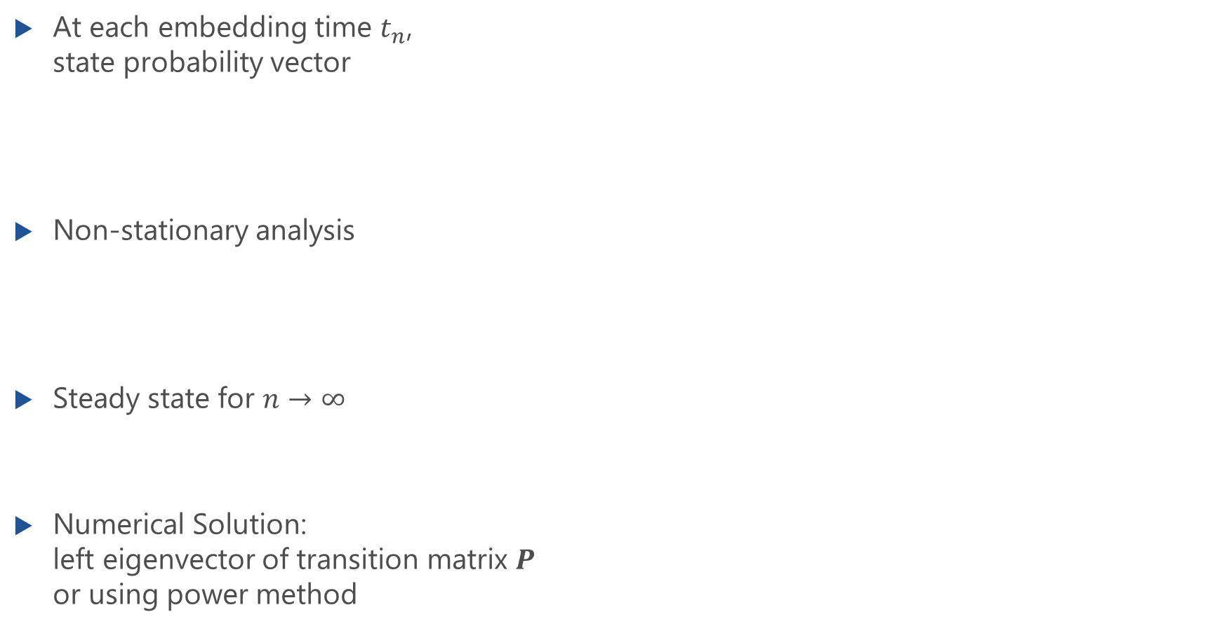
State Probabilities and System Characteristics
At each embedding time $t_{n}$, state probability vector
Non-stationary analysis
Steady state for $n→∞$
Numerical Solution: left eigenvector of transition matrix $P$ or using power method

Slide 11
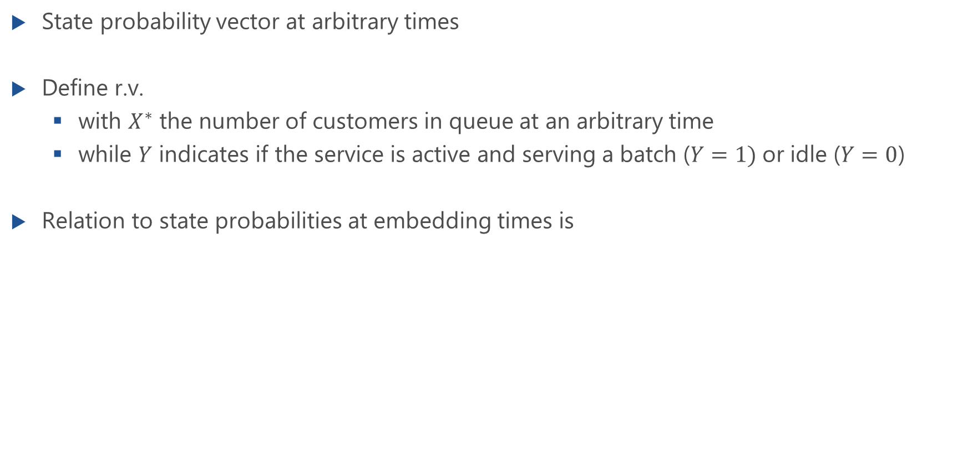
State Probabilities at Arbitrary Observation Times
State probability vector at arbitrary times
Define r.v.
with $X^{∗}$ the number of customers in queue at an arbitrary time
while $Y$ indicates if the service is active and serving a batch ($Y=1)$or idle ($Y=0$)
Relation to state probabilities at embedding times is
blocking
probability
mean waiting time

Slide 12
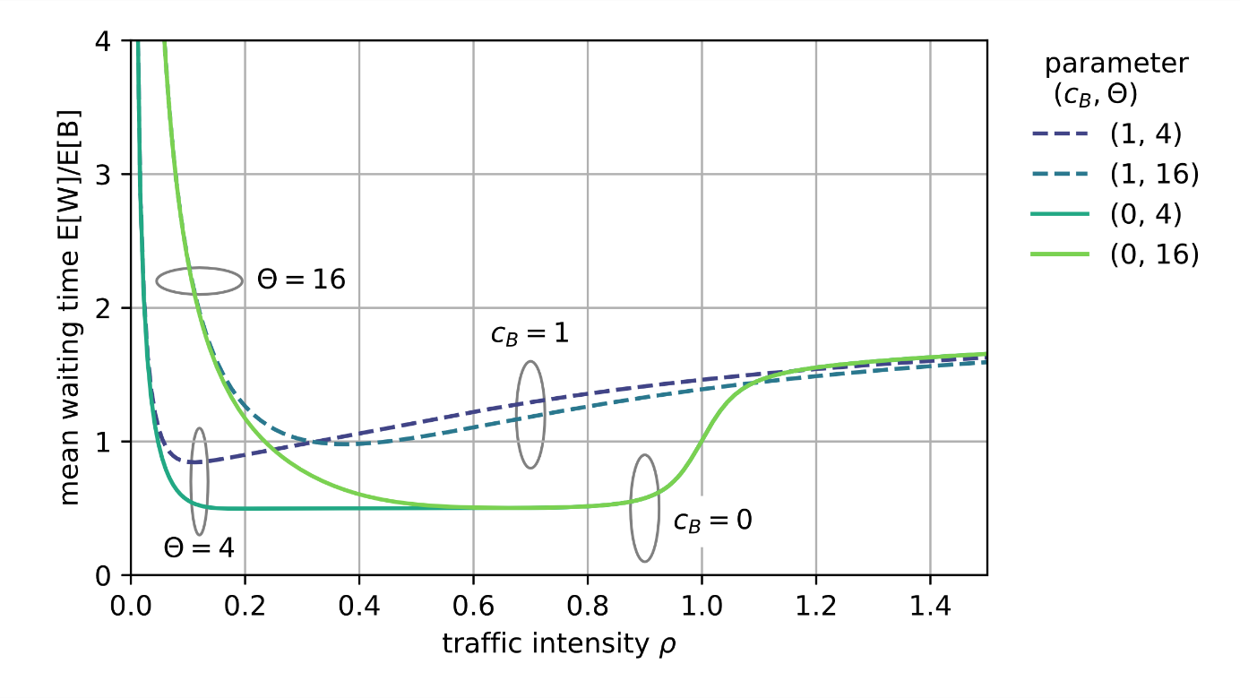
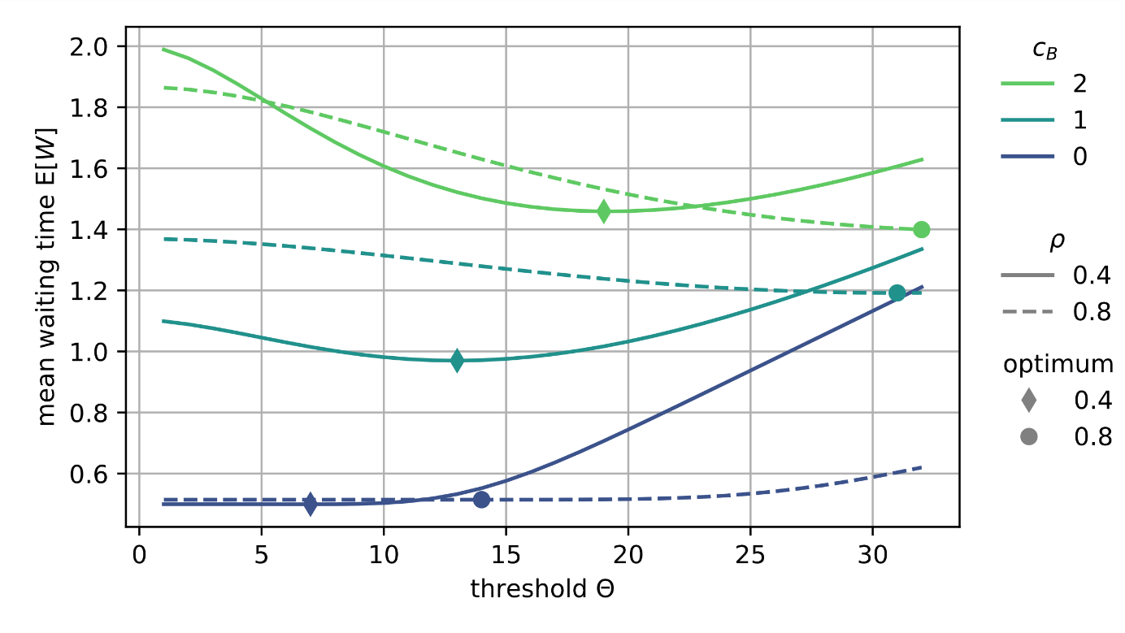
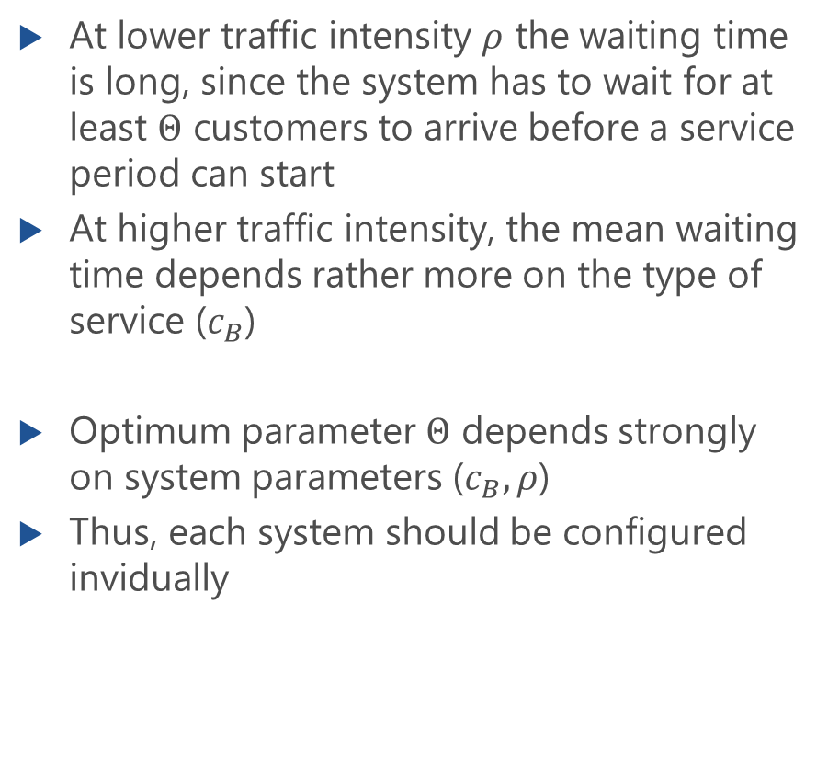
Numerical Results
At lower traffic intensity $ρ$ the waiting time is long, since the system has to wait for at least $Θ$ customers to arrive before a service period can start
At higher traffic intensity, the mean waiting time depends rather more on the type of service ($c_{B}$)
Optimum parameter $Θ$ depends strongly on system parameters ($c_{B},ρ$)
Thus, each system should be configured invidually

